Slide 1
OCI Networking 101
ACE Solutions Architecture Team

Slide 2
OCI Hierarchy
Company
Tenancy
(root compartment)
P1
P2
P3
P4
Px
Py
Compartments
R1
Rn
Resources
Notes:
In OCI we have a root compartment, that you can consider as the root structure of your organization.
You can have compartments and sub-compartments.
Compartments can be structured with multiple layers.
The lowest layer is the resources, where you vms live
Tenancy is the master paying account.

Slide 3
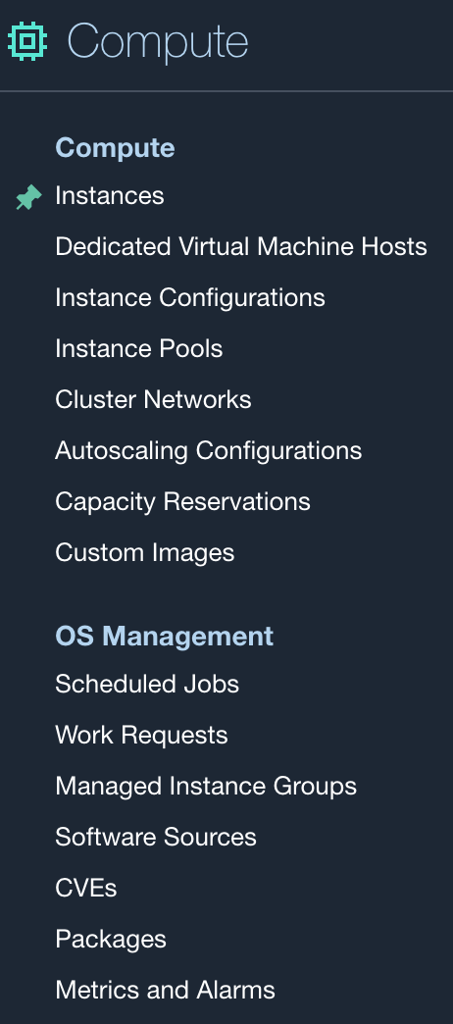
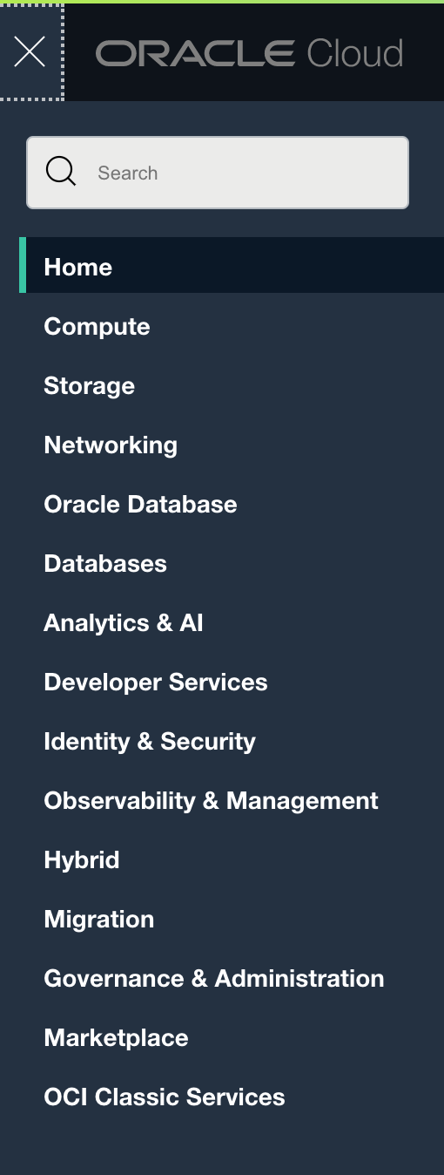
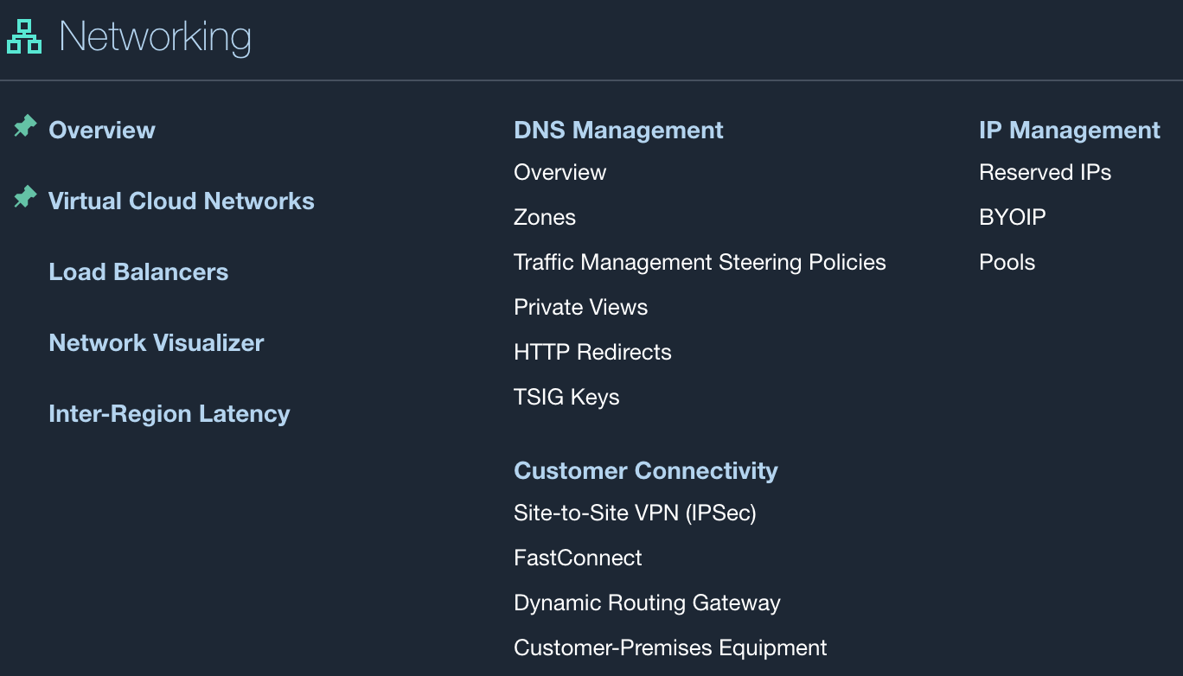
Oracle Services and Resources
Compute Resources
Console Snapshot
IaaS (Core) + Database
Networking Resources
Notes:
We have the same methodology with a catalog of services that we can NAVIGATE THROUGH from the dashboard.
Fastconnect is the name of the private connection between the on-prem network and oci.

Slide 4
Oracle Important Services
Service Name | Purpose
Compute | Run instances (virtual machine or bare-metal)
IAM | Identity and Access Management
VCN | Virtual Cloud Network
Block Volume | Storage
FastConnect | Connecting On-Prem
DNS Zone Management | DNS
Notes:
Again the same common services, my apologies for this repetation.

Slide 5
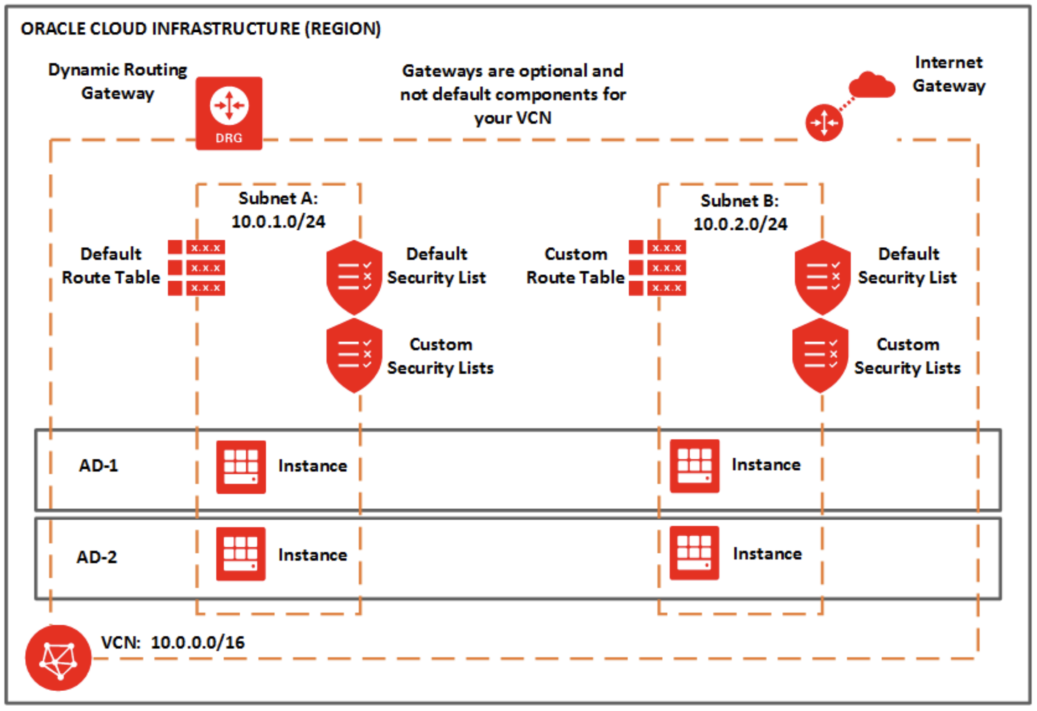

Slide 7
Notes:
Subnets can span multiple availability domains, but not multiple VCNs. If you create a regional subnet, the subnet's resources can reside in any availability domain (AD) in the region. However, if you create an AD-specific subnet, the subnet's resources must reside in the subnet's particular availability domain.
Limited Overlapping IP support (only within a VCN). However, if you intend to connect a VCN to your on-premise network or another VCN, we recommend you ensure that the IP address ranges don’t overlap.
https://www.oracle.com/ca-en/cloud/networking/virtual-cloud-network-faq.html

Slide 8

Notes:
A VCN route table contains rules to route traffic that's ultimately destined for locations outside the VCN.
Each rule in a route table has a destination CIDR block and a route target. When the subnet's outgoing traffic matches the destination CIDR block of the route rule, traffic is routed to the route target. Examples of common route targets include: an internet gateway or a dynamic routing gateway.
https://www.oracle.com/ca-en/cloud/networking/virtual-cloud-network-faq.html
Working with Route Tables and Route Rules
Each VCN automatically comes with a default route table that has no rules. If you don't specify otherwise, every subnet uses the VCN's default route table. When you add route rules to your VCN, you can simply add them to the default table if that suits your needs. However, if you need both a public subnet and a private subnet (for example, see Scenario C: Public and Private Subnets with a VPN), you instead create a separate (custom) route table for each subnet.
Each subnet in a VCN uses a single route table. When you create the subnet, you specify which one to use. You can change which route table the subnet uses at any time. You can also edit a route table's rules or remove all the rules from the table.

Slide 9
Notes:
A VCN route table contains rules to route traffic that's ultimately destined for locations outside the VCN.
Each rule in a route table has a destination CIDR block and a route target. When the subnet's outgoing traffic matches the destination CIDR block of the route rule, traffic is routed to the route target. Examples of common route targets include: an internet gateway or a dynamic routing gateway.
https://www.oracle.com/ca-en/cloud/networking/virtual-cloud-network-faq.html
Working with Route Tables and Route Rules
Each VCN automatically comes with a default route table that has no rules. If you don't specify otherwise, every subnet uses the VCN's default route table. When you add route rules to your VCN, you can simply add them to the default table if that suits your needs. However, if you need both a public subnet and a private subnet (for example, see Scenario C: Public and Private Subnets with a VPN), you instead create a separate (custom) route table for each subnet.
Each subnet in a VCN uses a single route table. When you create the subnet, you specify which one to use. You can change which route table the subnet uses at any time. You can also edit a route table's rules or remove all the rules from the table.

Slide 10
Notes:
A VCN route table contains rules to route traffic that's ultimately destined for locations outside the VCN.
Each rule in a route table has a destination CIDR block and a route target. When the subnet's outgoing traffic matches the destination CIDR block of the route rule, traffic is routed to the route target. Examples of common route targets include: an internet gateway or a dynamic routing gateway.
https://www.oracle.com/ca-en/cloud/networking/virtual-cloud-network-faq.html
Working with Route Tables and Route Rules
Each VCN automatically comes with a default route table that has no rules. If you don't specify otherwise, every subnet uses the VCN's default route table. When you add route rules to your VCN, you can simply add them to the default table if that suits your needs. However, if you need both a public subnet and a private subnet (for example, see Scenario C: Public and Private Subnets with a VPN), you instead create a separate (custom) route table for each subnet.
Each subnet in a VCN uses a single route table. When you create the subnet, you specify which one to use. You can change which route table the subnet uses at any time. You can also edit a route table's rules or remove all the rules from the table.

Slide 11
Oracle Native Network Constructs
Construct | Purpose
Dynamic Routing Gateway (DRG) | Transit hub entity. Used for interconnecting VCNs inside a region. Capable of establishing intra- and inter-region connections. Termination point for IPsec VPN and FastConnect circuits.
Service Gateway (SG) | Service gateway is regional and enables access only to supported Oracle services in the same region as the VCN.
Internet Gateway (IG) | Internet Gateway provides a path for network traffic between VCN and the internet
NAT Gateway (NG) | NAT Gateway provides an option for the private resources to access the public internet.
Local Peering Gateway (LPG) Effectively obsolete | Entity required to build a Local “VCN Peering” (within the same region)
Subnet | Subnets can be regional in OCI spanning Availability Domains
Route Table | Route Table consists of a set of route rules that provide mapping for the traffic from subnets via gateways to destinations outside the VCN
Notes:
The drg is a termination point for ipsec tunnel and fastconnect circuits.
The service gateway instead allows private connection from oci towards the oracle services in the public oci zone (it work like the endpoints in aws).
Internet gateway allows traffic between the oci infrastructure an internet
Nat gateway allows the private workloads to access internet for os upgrading or for sw-patching.
LPG or local peering gateway is considered almost obsolete after the adoption of the drg.

Slide 12
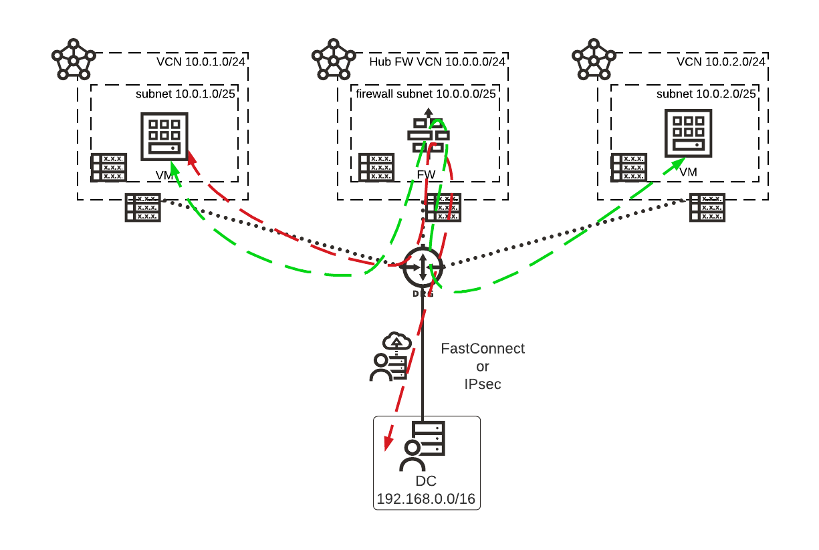
OCI DRG “2.0”
Spoke-VCN-1
Spoke-VCN-2
DRG “2.0” becomes transitive
DRG becomes the hub gateway supporting 300 attachments
Improvements for East-West traffic routing options
Design patterns allowing for FW insertion for traffic between VCNs or to on-prem (in the diagram)
Still requiring complex route table management, not supporting overlap, lacking visibility into the traffic flows, no traffic encryption controlled by the customer
Notes:
Let’s have a look at the DRG 2.0
We have three VCNs, and we have a hub/centralized fw, this is where I insert my checkpoint or Fortinet.
The drg is a construct in the middle.
The vcns get connected to the drg and also the on-prem network gets connected to the drg.
On the drg you terminate your ispec tunnel or the end point of the fast connect.
On the drg we can have multiple routing table and differentiate the traffic among different vcns.
Here you need to manually take care of all the constructs and be able to insert the fw in a proper way.

Slide 13
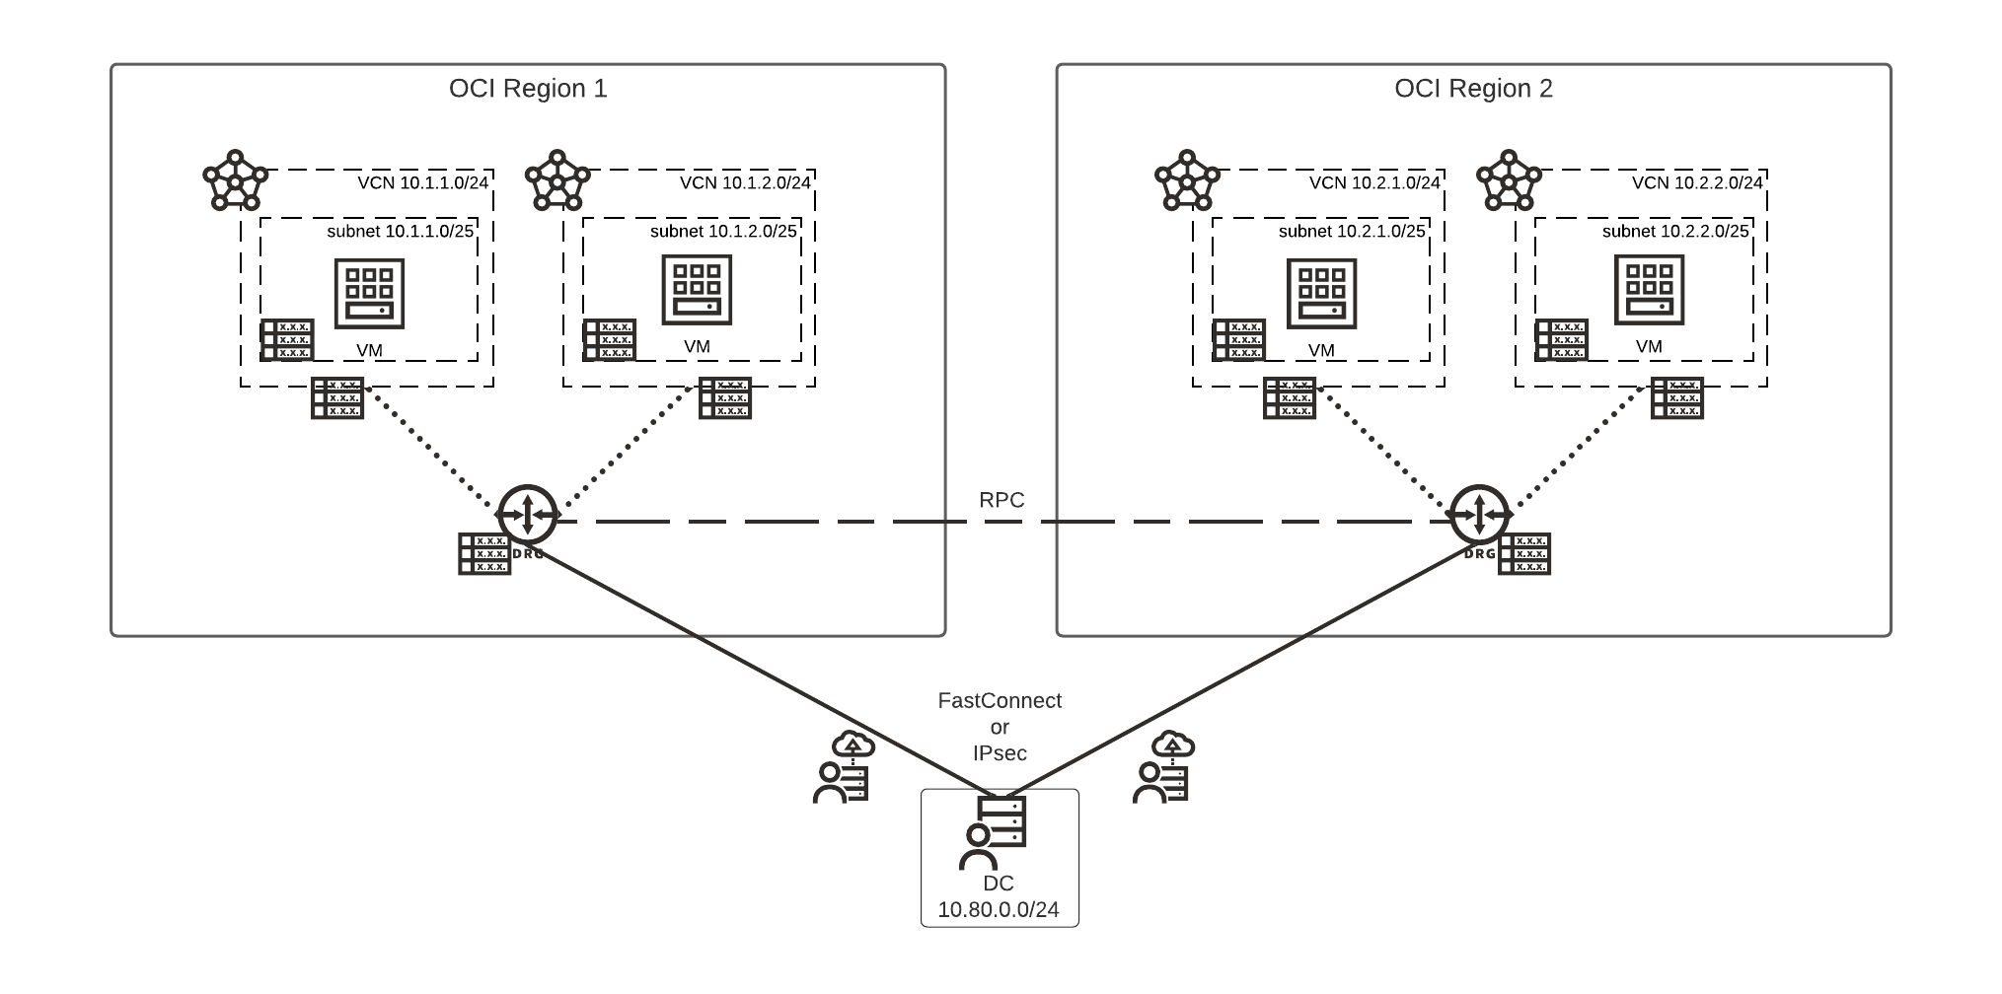
DRG Attachment Types and Route Tables
VCN Attachments
RPC Attachments (effectively “DRG peering”)
IPsec Attachments
FastConnect Attachments
Notes:
What I didn’t say before is that the drg exists in the scope of a region.
If you have resources in multiple regions, you need to deploy multiple drgs and then establish what is called RPC, the remote peering connection between two DRGs.

Slide 14
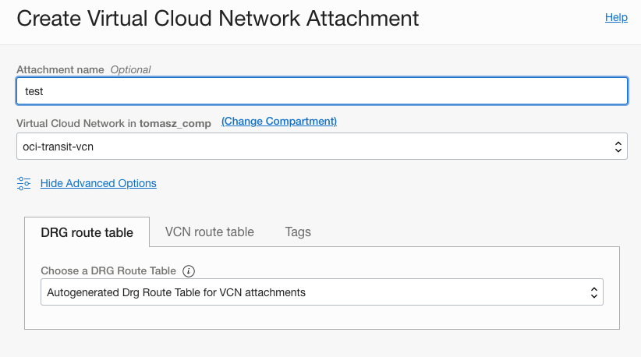
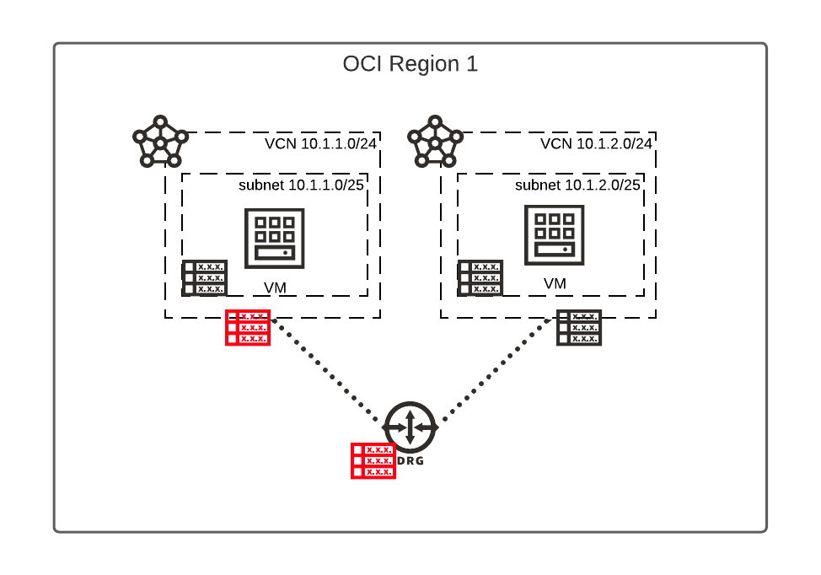
DRG Attachment Types and Route Tables
Each DRG attachment has an associated Route Table
Is used to route packets entering the DRG to their next hop
DRG supports multiple Route Tables
DRG route tables support automated Route Import and Export
Notes:
A VCN attachment has two route tables:. One DRG routing table for traffic entering the DRG, and one VCN routing table for traffic entering the VCN The DRG route table exists in the DRG and is used to route packets entering the DRG through the attachment. The VCN route table is used to route packets entering the VCN through the attachment. If a VCN routing table is not defined, a hidden implicit table always provides connectivity to all subnets in the VCN.
Similar for RPC (DRG peering)

Slide 15
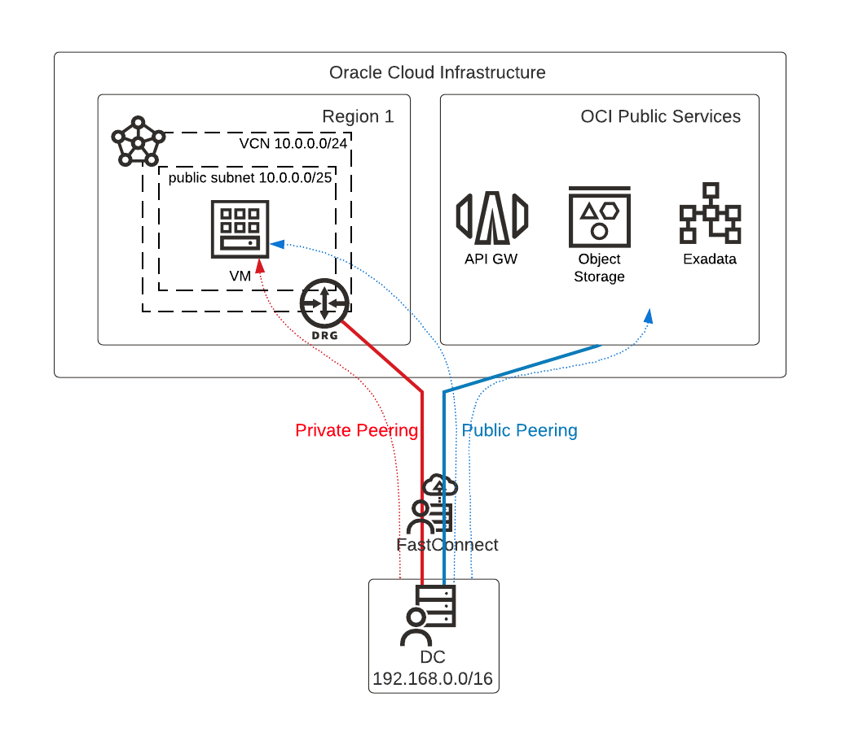
OCI DC to Cloud Access – Oracle FastConnect
Oracle Fast Connect is the private circuit you can build between your DC and OCI for high-throughput, low-latency, stable link.
It supports two types of peerings:
Private Peering – access to your VCN resources using Private IPs, over DRG
Public Peering – access to OCI Public Services (e.g., Object Storage) or Public IPs in your OCI public subnets (e.g., a public VM)
Notes:
The fastconnect link comprises two different kind of peerings:
Private peering – this allows to access the resources on a vcn but using private Ip solely
Public peering – this allows to access the resources inside the oci public zone, such as the object storage.

Slide 16
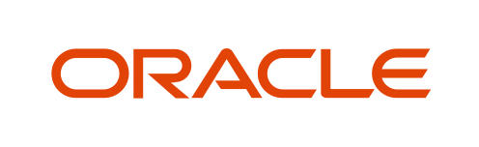



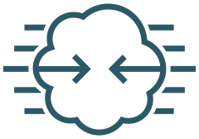

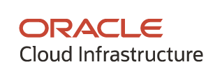
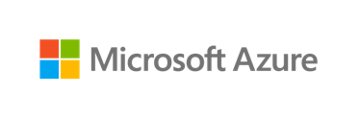
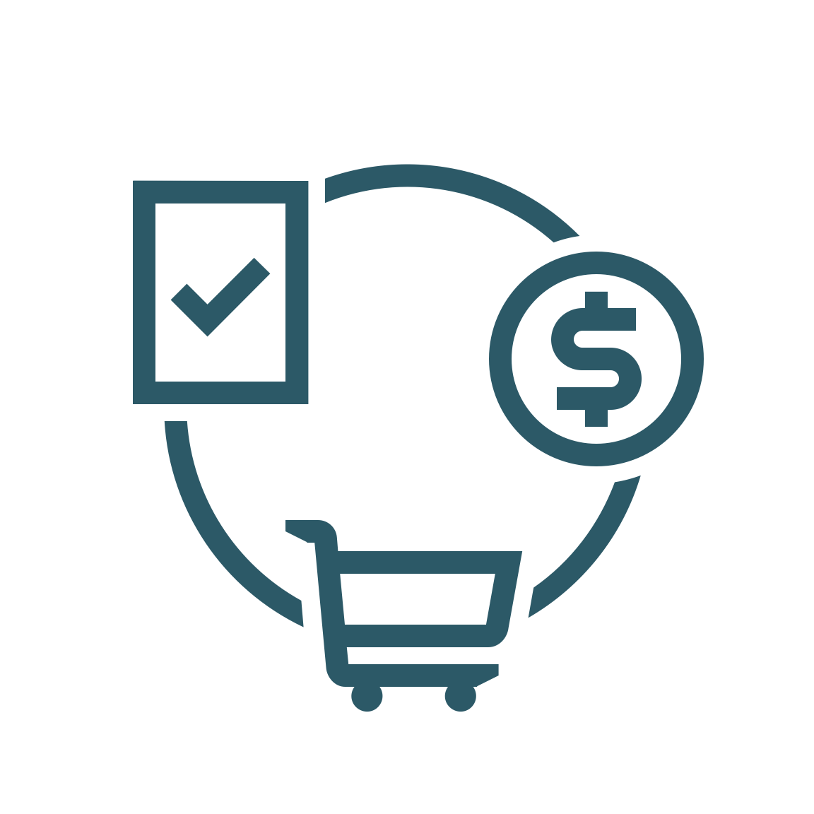
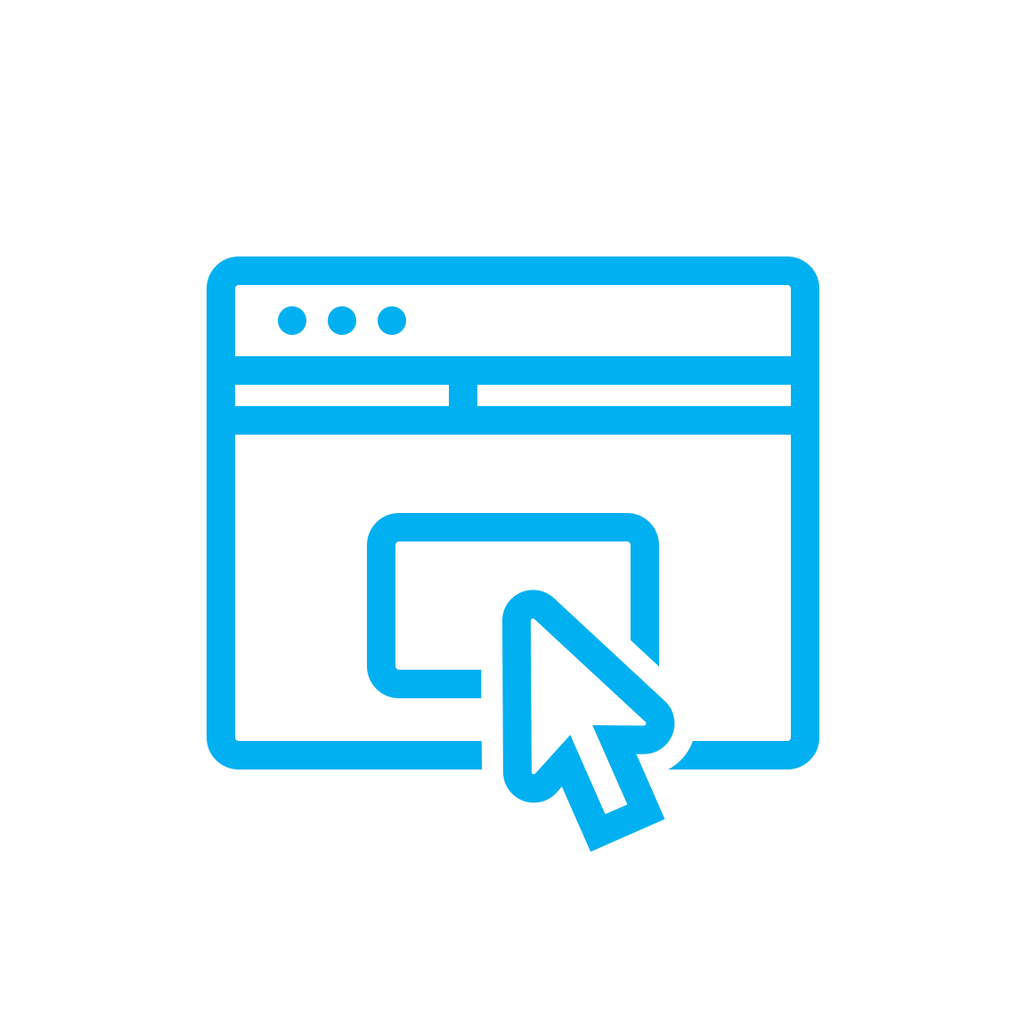
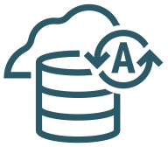
Connectivity – OCI/Azure Interconnect
Microsoft Azure and Oracle Cloud are interconnected today, so you can migrate and run mission-critical enterprise workloads across clouds
FastConnect and ExpressRoute direct connection with 2 millisecond latency and no intermediate service provider required
Unified identity and access management via single sign-on with automated user provisioning to easily manage resources across clouds
Collaborative support of workloads across clouds, for example, custom and Oracle Applications on Azure with Oracle Database cloud services – connect best-in-class services across clouds
Available Now: Ashburn, San Jose, Vinhedo, Toronto, London, Frankfurt, Amsterdam, Tokyo
Customer Premises
Equipment
Customer
Data Center
FastConnect/ VPN
ExpressRoute/ VPN
VCN
VNet
Autonomous DB / Exadata
Enterprise Applications
FastConnect
ExpressRoute
Microsoft Applications
Azure Services
ORACLE CLOUD INFRASTRUCTURE (Ashburn)
MICROSOFT AZURE (US East region)
Notes:
The Oracle and Microsoft cloud interoperability partnership enables customers to migrate and run mission-critical enterprise workloads across Microsoft Azure and Oracle Cloud. Enterprises can now seamlessly connect Azure services, like Analytics and AI, to Oracle Cloud services, like Autonomous Database. By enabling customers to run one part of a workload within Azure and another part of the same workload within the Oracle Cloud, the partnership delivers a highly optimized, best-of-both-clouds experience. Taken together, Azure and Oracle Cloud offer customers a one-stop shop for all the cloud services and applications they need to run their entire business.

Slide 17
OCI Networking Summary
Positives
DRG 2.0 is significantly better than DRG 1.0
It is mostly free
Egress data charges to the internet only after 10 TB monthly
FastConnect data is free in/out
Core Challenges
It is not a multi-cloud solution
Choice of Encryption (important for financial institutions etc.) – MACsec only on RPCs, not controlled by the customer
Other Challenges
Limited visibility
You don’t know exactly why the best route in DRG becomes the selected one
No traffic-level visibility
No way to control AS path length when advertising CIDRs from DRG to external
Configuration of the RTs in VCNs does not happen automatically (route export not supported for VCN)
Prone to errors
Difficult to troubleshoot
Management at scale, even with route import/export, can be challenging

Slide 18
Next: MCNA

Slide 19
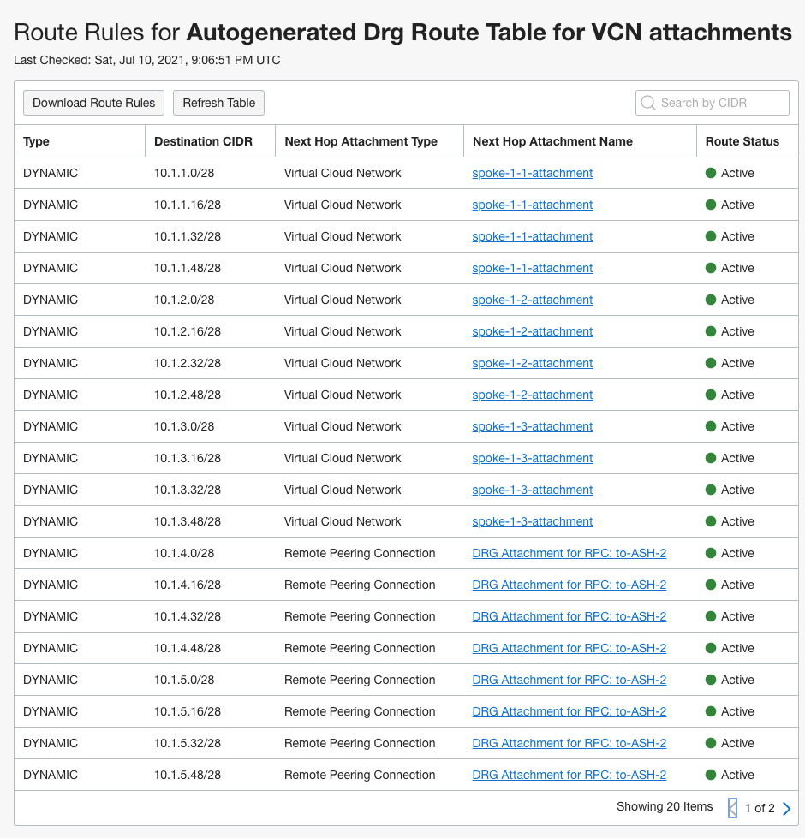
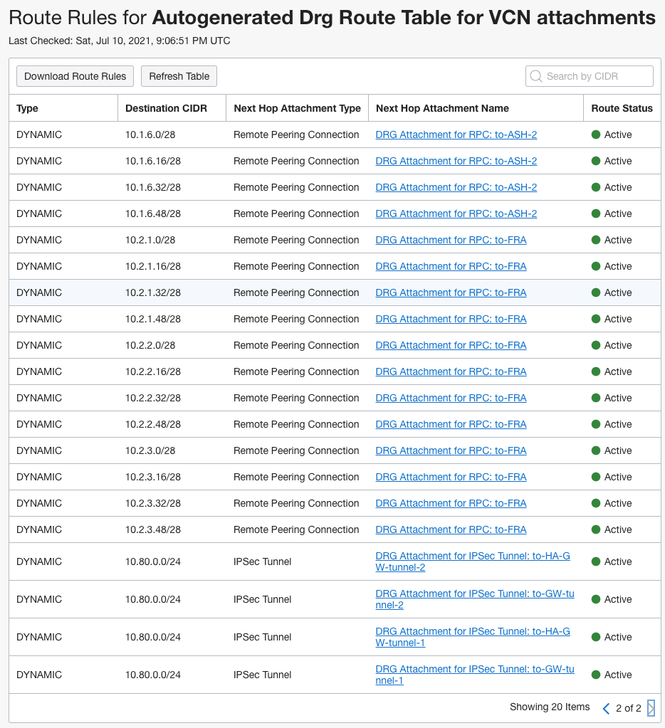

Slide 20
DRGv2 Attach Types and Route Tables
IP Packet
Each VCN, FastConnect, IPsec, or RPC connection is connected to the DRG via attachment
Each attachment has a route table assigned, which directs ingress traffic to a specific egress attachment
A packet arrives from VCN or on-premise to the DRG
The DRG routing engine determines which attachment to egress the packet out of based on the associated route table
Route Table #2, #3, etc
Route Target: Dest Att
On-Premise
Route Target: Dest Att
3
IPsec
Attachment
IPsec
Attachment
FastConnect
Attachment
DRG 2
DRG Routing Engine
RPC
Attachment
RPC
Attachment
VCN 1
Attachment
VCN 2
Attachment
VCN 3
Attachment
1
2
VCNs
Route Table #1
Route Target: Dst Attributes
IP Packet
Route Target: Dst Attributes
Notes:
Packet arrives DRG from attached VCN or on-premises (via FC/IPSEC attachment), or remote region (RPC attachment).
A route lookup is preformed on the route table associated with the ingress attachment.
The packet is forwarded by the DRG routing engine out an egress attachment

